Slide 1
Test_181019
윤민재

Slide 2
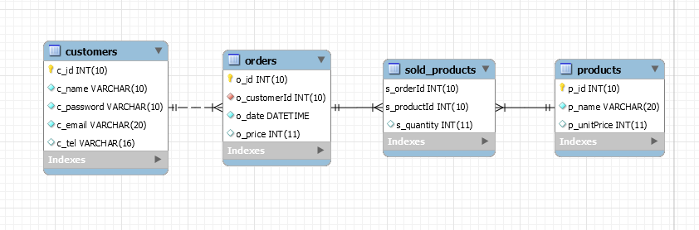
Exam 16

Slide 3
Exam 16
/* 사용자 정보 */
CREATE TABLE `customers` (
`c_id` INT(10) UNSIGNED NOT NULL AUTO_INCREMENT,
`c_name` VARCHAR(10) NOT NULL,
`c_password` VARCHAR(10) NOT NULL,
`c_email` VARCHAR(20) NOT NULL,
`c_tel` VARCHAR(16) NULL DEFAULT NULL,
PRIMARY KEY (`c_id`)
);
/* 제품 정보 */
CREATE TABLE `products` (
`p_id` INT(10) UNSIGNED NOT NULL AUTO_INCREMENT,
`p_name` VARCHAR(20) NOT NULL,
`p_unitPrice` INT(11) NULL DEFAULT '0',
PRIMARY KEY (`p_id`)
);

Slide 4
Exam 16
/* 장바구니 정보 (제품을 필요한 만큼 구입하기) */
CREATE TABLE `sold_products` (
`s_orderId` INT(10) UNSIGNED NOT NULL,
`s_productId` INT(10) UNSIGNED NOT NULL,
`s_quantity` INT(11) NULL DEFAULT '0',
PRIMARY KEY (`s_orderId`, `s_productId`),
INDEX `s_productId` (`s_productId`),
CONSTRAINT `sold_products_ibfk_1` FOREIGN KEY (`s_orderId`) REFERENCES `orders` (`o_id`),
CONSTRAINT `sold_products_ibfk_2` FOREIGN KEY (`s_productId`) REFERENCES `products` (`p_id`)
);
/* 주문 정보 (총가격) */
CREATE TABLE `orders` (
`o_id` INT(10) UNSIGNED NOT NULL AUTO_INCREMENT,
`o_customerId` INT(10) UNSIGNED NOT NULL,
`o_date` DATETIME NOT NULL DEFAULT CURRENT_TIMESTAMP,
`o_price` INT(11) NULL DEFAULT '0',
PRIMARY KEY (`o_id`),
INDEX `o_customerId` (`o_customerId`),
CONSTRAINT `orders_ibfk_1` FOREIGN KEY (`o_customerId`) REFERENCES `customers` (`c_id`)
);

Slide 5
Exam 16
/* 일별 매출액 */
SELECT p.p_id, p.p_name, p.p_unitPrice, SUM(sp.s_quantity), SUM(sp.s_quantity*p.p_unitPrice)
FROM products AS p
JOIN sold_products AS sp ON p.p_id =sp.s_productId
JOIN orders AS o ON sp.s_orderId = o.o_id
WHERE DATE(o.o_date) = '" + year + "-" + month + "-" + day + "'
GROUP BY p.p_id;
/* 단, year , month , day는 외부에서 입력받음 */

Slide 6
Exam 17
SELECT *
FROM city
WHERE Population >1000000 AND CountryCode = 'kor';

